Slide 1
GRADE 7 ACCELERATED · UNIT 3 · LESSON 9
Writing Small Numbers in Scientific Notation
MA.8.NSO.1.4
I can write very small numbers in scientific notation, read them back, and find how many times larger or smaller one number is than another.
Yesterday the exponents on the 10 were positive.
Today they are negative — and the numbers get very small.
Grade 7 Accelerated · Unit 3 · Lesson 9 — Writing Small Numbers in Scientific Notation
1

Slide 2

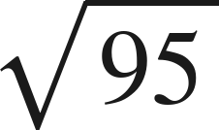
Warm-Up
On your own. Four minutes. No notes.
1. Write 4,300,000 in scientific notation.
2. Write
as a fraction.
3.
is between which two whole numbers?
4. Write 0.007 as a fraction.
Grade 7 Accelerated · Unit 3 · Lesson 9 — Writing Small Numbers in Scientific Notation
2

Slide 3
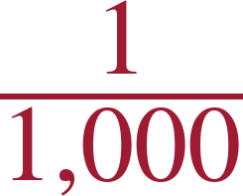
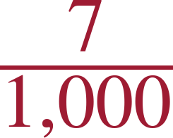
Warm-Up
Answers.
1. Write 4,300,000 in scientific notation.
4.3 × 10⁶
2. Write
as a fraction.
3.
is between which two whole numbers?
9 and 10
4. Write 0.007 as a fraction.
Grade 7 Accelerated · Unit 3 · Lesson 9 — Writing Small Numbers in Scientific Notation
3

Slide 4
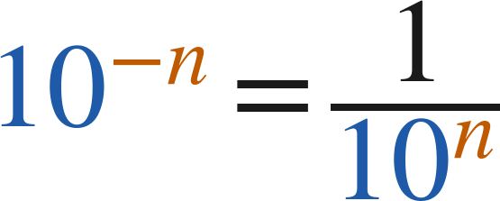
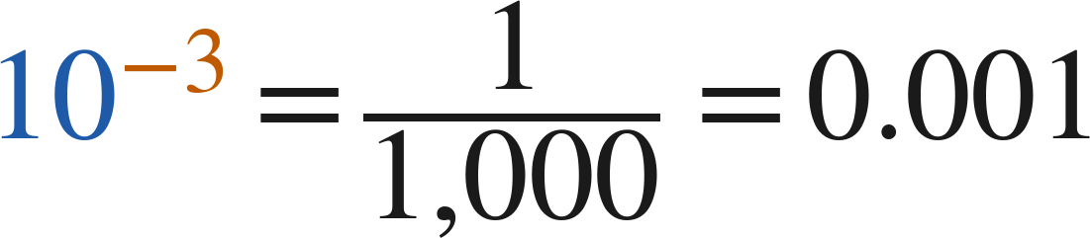
Notes
Copy the table.
I. Negative powers of ten name the decimal places
10⁰ | 10⁻¹ | 10⁻² | 10⁻³ | 10⁻⁴ | 10⁻⁵
1 | 0.1 | 0.01 | 0.001 | 0.0001 | 0.00001
A negative exponent puts the 1 in that decimal place: 10⁻⁴ is a 1 in the fourth place.
Grade 7 Accelerated · Unit 3 · Lesson 9 — Writing Small Numbers in Scientific Notation
4

Slide 5
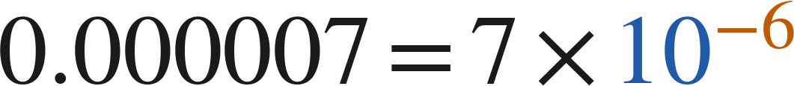
Notes
II. Small numbers in scientific notation
The coefficient is still at least 1 and less than 10. The exponent is negative for a number less than 1.
The exponent is how many places the point moves: 0.0000672 → 6.72 is five places right, so 10⁻⁵.
Grade 7 Accelerated · Unit 3 · Lesson 9 — Writing Small Numbers in Scientific Notation
5

Slide 6
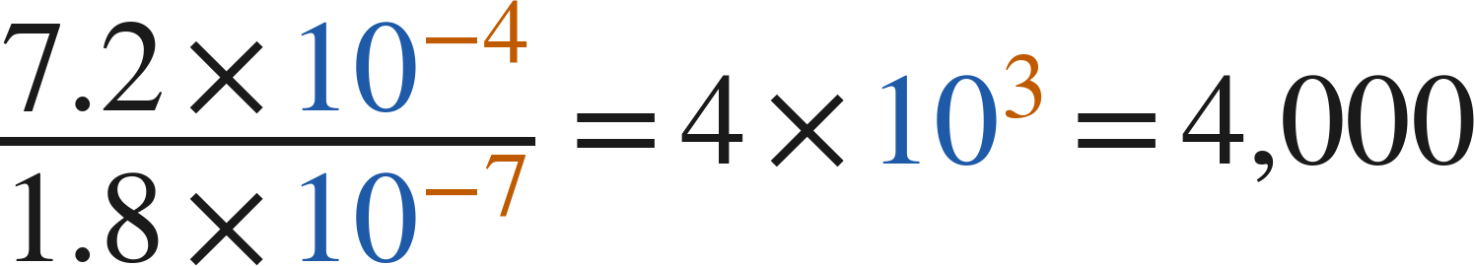
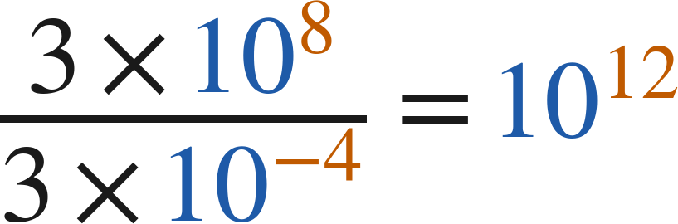
Notes
III. How many times larger — or smaller?
Divide the coefficients. Divide the powers of 10 — subtract the exponents. Multiply the results.
Which is bigger, 10⁻⁵ or 10⁻⁸? The one with the larger exponent: −5 > −8, so 10⁻⁵.
Grade 7 Accelerated · Unit 3 · Lesson 9 — Writing Small Numbers in Scientific Notation
6

Slide 7
Example 1
A quantity in words, to scientific notation.
The density of oxygen is 1,332 millionths of a gram per cubic centimeter.
Write this value as a decimal, then in scientific notation.
Grade 7 Accelerated · Unit 3 · Lesson 9 — Writing Small Numbers in Scientific Notation
7

Slide 8
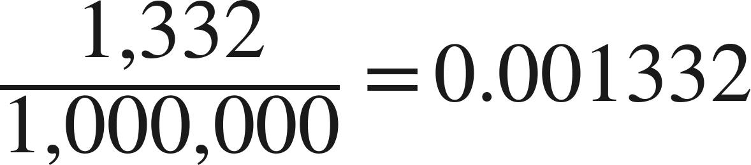
Example 1
Worked.
1,332 millionths, as a decimal
the 1 is in the thousandths place
Answer: 0.001332 = 1.332 × 10⁻³
Grade 7 Accelerated · Unit 3 · Lesson 9 — Writing Small Numbers in Scientific Notation
8

Slide 9
Your Turn
Same steps, your numbers. Boards up when done.
A human hair is about 67 hundred-thousandths of an inch thick.
Write this value in scientific notation.
Grade 7 Accelerated · Unit 3 · Lesson 9 — Writing Small Numbers in Scientific Notation
9

Slide 10
Your Turn
Answer.
A human hair is about 67 hundred-thousandths of an inch thick.
Write this value in scientific notation.
0.00067 — the 6 is in the ten-thousandths place
Answer: 6.7 × 10⁻⁴
Grade 7 Accelerated · Unit 3 · Lesson 9 — Writing Small Numbers in Scientific Notation
10

Slide 11
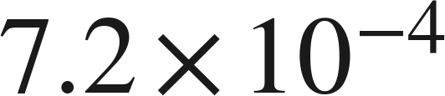
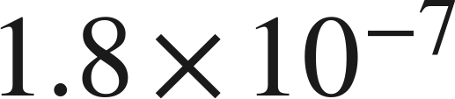
Example 2
How many times larger?
How many times larger is
than
?
Grade 7 Accelerated · Unit 3 · Lesson 9 — Writing Small Numbers in Scientific Notation
11

Slide 12
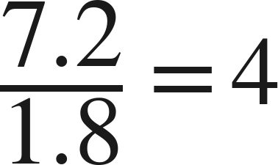
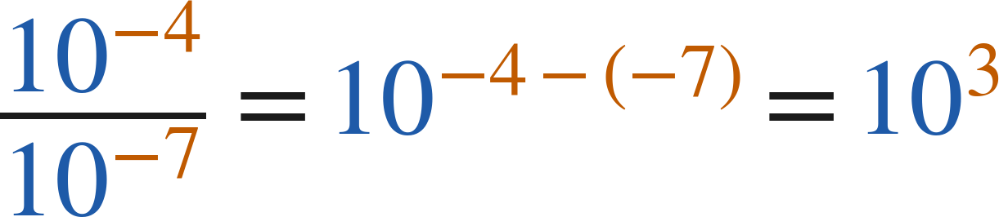
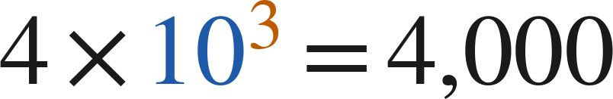
Example 2
Worked.
coefficients
powers of 10: −4 − (−7) = 3
multiply the two results
Answer: 4,000 times larger
Grade 7 Accelerated · Unit 3 · Lesson 9 — Writing Small Numbers in Scientific Notation
12

Slide 13
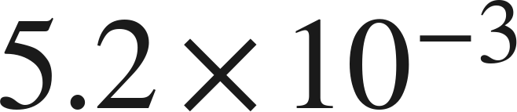
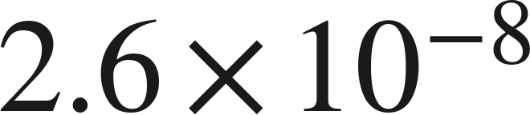
Your Turn
Same steps, your numbers. Boards up when done.
How many times larger is
than
?
Grade 7 Accelerated · Unit 3 · Lesson 9 — Writing Small Numbers in Scientific Notation
13

Slide 14
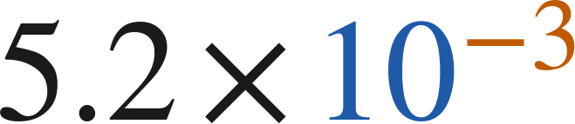
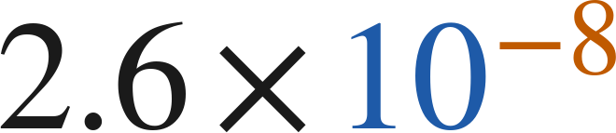
Your Turn
Answer.
How many times larger is
than
?
2 × 10⁵
Answer: 200,000 times larger
Grade 7 Accelerated · Unit 3 · Lesson 9 — Writing Small Numbers in Scientific Notation
14

Slide 15
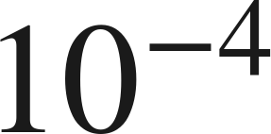
Whiteboards · Question 1 of 9
Boards up on three.
Answer it.
Write it as a decimal.
Grade 7 Accelerated · Unit 3 · Lesson 9 — Writing Small Numbers in Scientific Notation
15

Slide 16
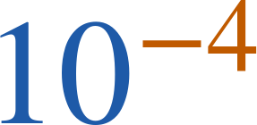
Whiteboards · Question 1 of 9
Answer.
a 1 in the fourth decimal place
Answer: 0.0001
Grade 7 Accelerated · Unit 3 · Lesson 9 — Writing Small Numbers in Scientific Notation
16

Slide 17
Whiteboards · Question 2 of 9
Boards up on three.
Write 0.003 in scientific notation.
Answer it.
Which place is the 3 in?
Grade 7 Accelerated · Unit 3 · Lesson 9 — Writing Small Numbers in Scientific Notation
17

Slide 18
Whiteboards · Question 2 of 9
Answer.
Write 0.003 in scientific notation.
3 thousandths
Answer: 3 × 10⁻³
Grade 7 Accelerated · Unit 3 · Lesson 9 — Writing Small Numbers in Scientific Notation
18

Slide 19
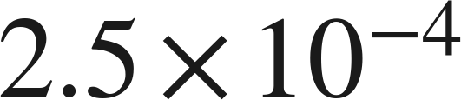
Whiteboards · Question 3 of 9
Boards up on three.
Write
in standard form.
Answer it.
Move the point four places left.
Grade 7 Accelerated · Unit 3 · Lesson 9 — Writing Small Numbers in Scientific Notation
19

Slide 20
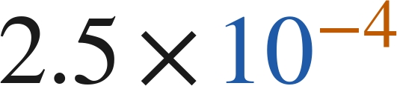
Whiteboards · Question 3 of 9
Answer.
Write
in standard form.
the 2 lands in the ten-thousandths place
Answer: 0.00025
Grade 7 Accelerated · Unit 3 · Lesson 9 — Writing Small Numbers in Scientific Notation
20

Slide 21
Whiteboards · Question 4 of 9
Boards up on three.
A machine's cutting tolerance is 0.0000988 inch.
The part it cuts is 4 inches long.
Write the tolerance in scientific notation.
Answer it.
Every nonzero digit stays in the coefficient.
Grade 7 Accelerated · Unit 3 · Lesson 9 — Writing Small Numbers in Scientific Notation
21

Slide 22
Whiteboards · Question 4 of 9
Answer.
A machine's cutting tolerance is 0.0000988 inch.
The part it cuts is 4 inches long.
Write the tolerance in scientific notation.
the 9 is in the hundred-thousandths place
Answer: 9.88 × 10⁻⁵
Grade 7 Accelerated · Unit 3 · Lesson 9 — Writing Small Numbers in Scientific Notation
22

Slide 23
Whiteboards · Question 5 of 9
Boards up on three.
Which is 0.00081 written in scientific notation?
A. 8.1 × 10⁻⁴
B. 8.1 × 10⁻³
C. 81 × 10⁻⁵
D. 8.1 × 10⁴
Answer it.
Grade 7 Accelerated · Unit 3 · Lesson 9 — Writing Small Numbers in Scientific Notation
23

Slide 24
Whiteboards · Question 5 of 9
Answer.
Which is 0.00081 written in scientific notation?
A. 8.1 × 10⁻⁴
B. 8.1 × 10⁻³
C. 81 × 10⁻⁵
D. 8.1 × 10⁴
Answer: A — 8.1 × 10⁻⁴
Grade 7 Accelerated · Unit 3 · Lesson 9 — Writing Small Numbers in Scientific Notation
24

Slide 25
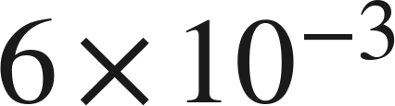
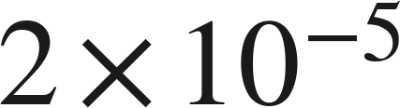
Whiteboards · Question 6 of 9
Boards up on three.
How many times larger is
than
?
A. 300
B. 3
C. 30
D. 0.03
Answer it.
Grade 7 Accelerated · Unit 3 · Lesson 9 — Writing Small Numbers in Scientific Notation
25

Slide 26
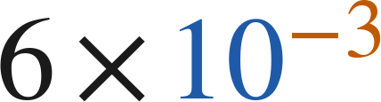
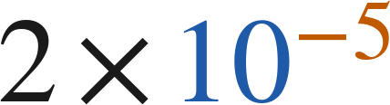
Whiteboards · Question 6 of 9
Answer.
How many times larger is
than
?
A. 300
B. 3
C. 30
D. 0.03
Answer: A — 300
Grade 7 Accelerated · Unit 3 · Lesson 9 — Writing Small Numbers in Scientific Notation
26

Slide 27
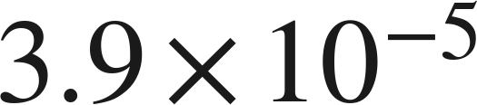
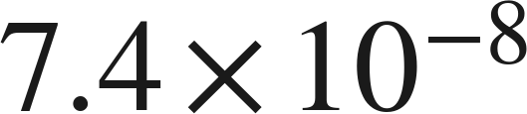
Whiteboards · Question 7 of 9
Boards up on three.
Which is greater,
or
?
Answer it.
Compare the exponents first.
Grade 7 Accelerated · Unit 3 · Lesson 9 — Writing Small Numbers in Scientific Notation
27

Slide 28
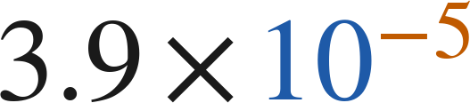
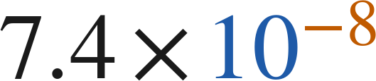
Whiteboards · Question 7 of 9
Answer.
Which is greater,
or
?
−5 > −8, so 10⁻⁵ is the larger power
Answer: 3.9 × 10⁻⁵
Grade 7 Accelerated · Unit 3 · Lesson 9 — Writing Small Numbers in Scientific Notation
28

Slide 29
Whiteboards · Question 8 of 9
Boards up on three.
A computer displays a number as 4.2E−6.
Write the number in standard form.
Answer it.
E−6 means × 10⁻⁶.
Grade 7 Accelerated · Unit 3 · Lesson 9 — Writing Small Numbers in Scientific Notation
29

Slide 30
Whiteboards · Question 8 of 9
Answer.
A computer displays a number as 4.2E−6.
Write the number in standard form.
4.2 × 10⁻⁶
Answer: 0.0000042
Grade 7 Accelerated · Unit 3 · Lesson 9 — Writing Small Numbers in Scientific Notation
30

Slide 31
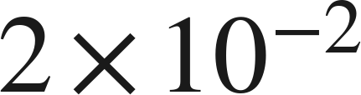
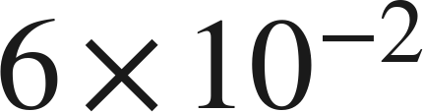
Whiteboards · Question 9 of 9
Take your time. Boards up when you have written it.
Fishing line A is
inch thick.
Fishing line B is
inch thick.
Which is thicker, and how many times? Name a thickness between them.
Write your answer in sentences.
Same power of 10 — compare the coefficients.
Grade 7 Accelerated · Unit 3 · Lesson 9 — Writing Small Numbers in Scientific Notation
31

Slide 32
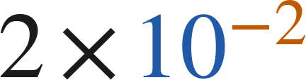
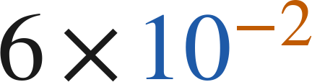
Whiteboards · Question 9 of 9
Answer.
Fishing line A is
inch thick.
Fishing line B is
inch thick.
Which is thicker, and how many times? Name a thickness between them.
0.02 in and 0.06 in
Answer: B; 3 times; e.g. 4 × 10⁻² in.
Grade 7 Accelerated · Unit 3 · Lesson 9 — Writing Small Numbers in Scientific Notation
32

Slide 33
Independent Set
Six questions. On your own, in silence.
1.
Six questions. Work down the page.
2.
Show the step that does the work, not just the answer.
3.
Silence until the six minutes are up.
Grade 7 Accelerated · Unit 3 · Lesson 9 — Writing Small Numbers in Scientific Notation
33

Slide 34
IXL
Last five minutes.
1.
Open IXL and start today's skills.
2.
Work on paper where the question needs work. The answer box does not show it.
3.
Every skill listed is required, to a SmartScore of 67. Due at the start of the next class.
Today's skills — all required
Convert between standard and scientific notation: small numbers — 85M
Compare small numbers — KDR
Powers of ten with negative exponents — SKD
Grade 7 Accelerated · Unit 3 · Lesson 9 — Writing Small Numbers in Scientific Notation
34

